Slide 1
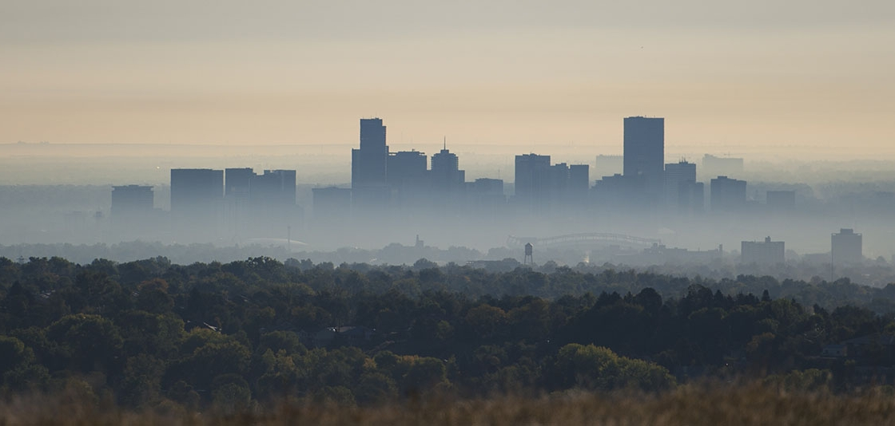
Vizualizing Air quality across the united states
Joey bero, zack capets, joseph rafferty, karl parvez, kahsay, harold flack

Slide 2
Project goal
Construct a visualization tool that displays information about current air quality across the United States aggregated by CBSA(Core-Based Statistical Area).
  A CBSA consists of one or more counties anchored by an urban center of at least 10,000 people plus adjacent counties that are socioeconomically tied to the urban center by commuting.

Slide 3
ETL process
Extract, transform, load

Slide 4
Extract
Fetch data from the US EPA Air Quality System API
API calls consist of data samples for specific air quality parameters, returned in JSON format
  Carbon Monoxide
  Sulfur Dioxide
  Ozone
  PM 10 Particulate Matter
  PM 2.5 Particulate Matter
Flask app hosted on: https://www.pythonanywhere.com/
  URL: http://usairqualityoverview.pythonanywhere.com/
  API calls will be submitted every time the user selects a new map view
  Flask app will obtain JSONs from the API calls and push them to MongoDB. Data will be stored as a JSON

Slide 5
Transform
Data integrity is from trusted source but still requires some cleaning
JSON was formatted with “/” instead of “:” as expected

Slide 6
Load
Flask app will retrieve JSONs from MongoDB and make data accessible to the front end
Leaflet/D3 allow geographic aggregation and other functions including zooming
Web page will display the latest available data
  Dropdown selector on page will allow the user to choose the date and pollutant to display using layer control
Tool will show the top 10 and bottom 10 areas in the country for each selected pollutant

Slide 7
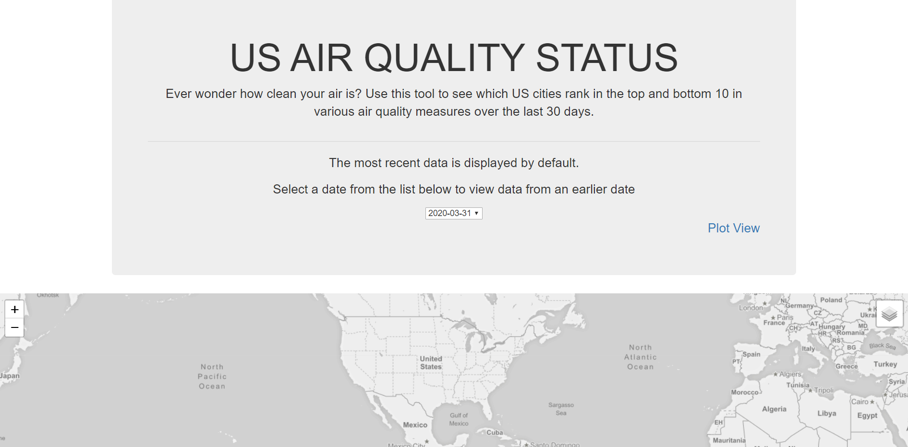
Homepage (need to update with working layers on map)

Slide 8
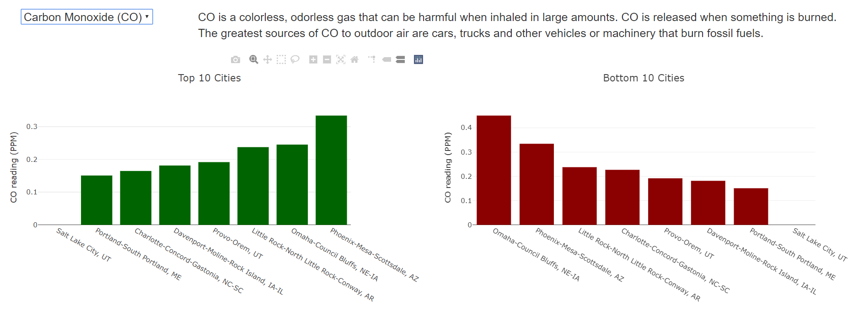
Carb0n monoxide

Slide 9
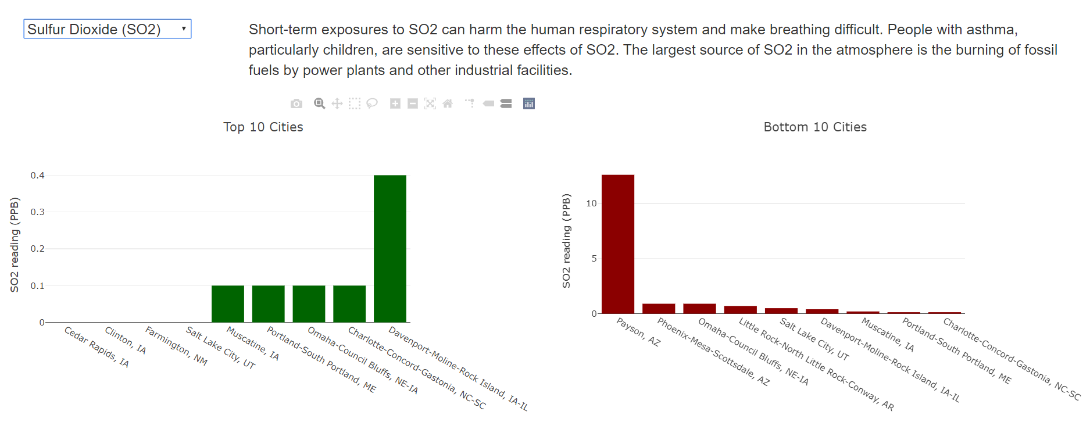
Sulfur dioxide

Slide 10
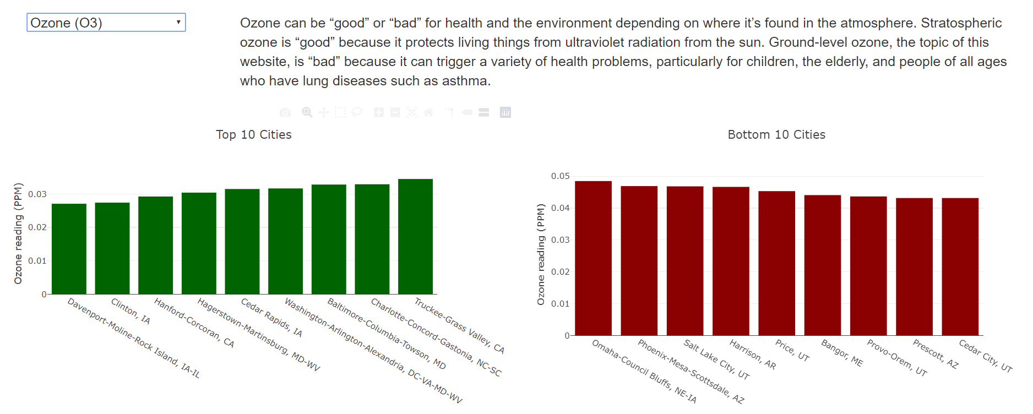
ozone

Slide 11
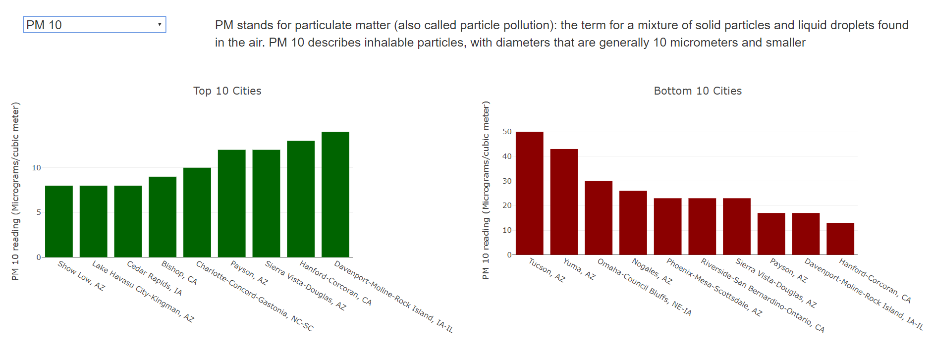
PM 10 (Particulate matter less than 10 micrometers)

Slide 12
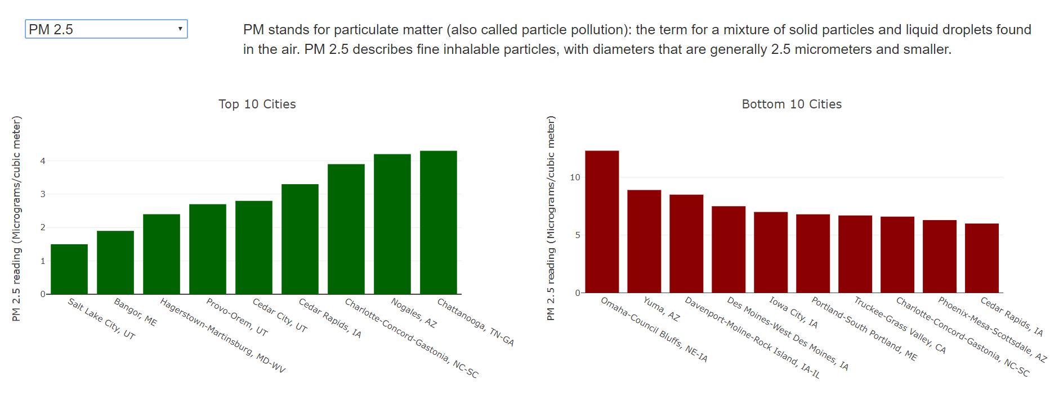
PM 2.5 (Particulate matter less than 2.5 micrometers)

